Slide 1
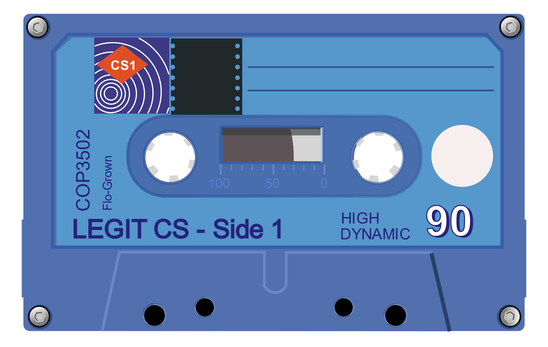
Data Types
“Data! Data! Data! I can’t make bricks without clay!”
Sir Arthur Conan Doyle
Notes:
.5 min

Slide 2
Overview of Built-in Types
Most built-in types are one of…
Numeric (number)
Sequence (ordered multiset)
Container (iterable*)
All Python values are one of…
Mutable (changeable)
Immutable (fixed)
Type | Category | Mutability
int | Numeric | Immutable
float | Numeric | Immutable
complex | Numeric | Immutable
list | Sequence | Mutable
tuple | Sequence | Immutable
string | Sequence* | Immutable
range | Sequence* | Immutable
dict | Container | Mutable
set | Container | Mutable
There are additional one-off special types too (e.g., function, file).
Notes:
12 min

Slide 3
Integer Binary Representation
Computers use binary for all data. Numbers are stored using binary numbering:
Characters are stored as numbers which represent their symbols:
Bit | Val.
0 | 1
1 | 2
2 | 4
3 | 8
4 | 16
5 | 32
6 | 64
7 | -128
A
B
Z
a
z
↵
!
65
66
90
97
122
13
33
01000001
01000010
01011010
01100001
01111010
00001101
00100001
73
01001001
64 + 8 + 1
Notes:
6 min

Slide 4
Octal and Hexadecimal
Octal (base-8, 3b) and hexadecimal (base-16, 4b) are frequently used in programming:
Octal
Hexidecimal
00000001
00000010
00011010
00100001
00111010
00001110
00010001
001
002
032
041
072
016
021
1
2
26
33
58
14
17
01000001
01000010
01011010
01100001
01111010
00001101
00100001
0x41
0x42
0x5A
0x61
0x7A
0x0D
0x21
65
66
90
97
122
13
33
A
B
Z
a
z
↵
!
By convention, octal is prefixed with ‘0’, while hex is prefixed with ‘0x’.
Binary numbers are prefixed with ‘0b’.
Notes:
6 min

Slide 5
Floating Point Numbers
We can use floating point numbers for radix-based numbers.
taxes.py
01 02 03 04 05 06 07
taxPercent = 10
print("What is the original cost of the item? ")
cost = float(input())
multiplier = 1.0 + taxPercent / 100
print ("Final cost:", cost * multiplier)
integer literal
floating point literal
promotion
OUTPUT:
What is the original cost of the item?
Final cost: 11.11.
10.10
Python automatically promotes integers as necessary for operations.
Notes:
2 min

Slide 6
Precision vs Accuracy
Floating point numbers give us better precision, but sometimes lower accuracy:
for_the_lulz.py
01 02 03 04 05 06 07 08 09
myLulz = 0.7
yourLulz = 0.4
lolDiff = myLulz - yourLulz
lolDiff -= 0.3
if lolDiff == 0:
print("SOMEONE TOOK ALL THE THINGS!")
else:
print("Difference is", lolDiff)
0.6999999999999999555910790
0.4000000000000000222044605
0.2999999999999999888977697
Not zero!
OUTPUT:
Difference is -5.551115123125783e-17
Notes:
3 min

Slide 7
Floating Point Comparison
To catch edge cases, define a delta value (buffer) for comparisons:
for_the_lulz.py
01 02 03 04 05 06 07 08 09
myLulz = 0.7
yourLulz = 0.4
lolDiff = myLulz - yourLulz
lolDiff -= 0.3
if lolDiff < 0.00001:
print("SOMEONE TOOK ALL THE THINGS!")
else:
print("Difference is", lolDiff)
Delta value
OUTPUT:
SOMEONE TOOK ALL THE THINGS!
Notes:
1.5 min

Slide 8
Complex Numbers
Python supports complex types as a built-in type.
import math
def phase(state):
return math.atan(state.imag / state.real)
def main():
circuit = complex(1, 2)
print("Phase", circuit, "is %.3f" % phase(circuit))
circuit = (2 + 1j) - 1j
print("Phase", circuit, "is %.3f" % phase(circuit))
print("i^i:", 1j ** 1j)
if __name__ == "__main__":
main() # Call main function
Phase (1+2j) is 1.107
Phase (2+0j) is 0.000
i^i: (0.20787957635076193+0j)
promotion
Notes:
8.5 min

Slide 9
Boolean Variables
We can store truth values using a boolean type:
magic.py
OUTPUT:
05 06 07 08 09 10 11 12 13 14 15 16 17 18 19
from random import randint
print("Try to guess my number (0-100)!")
magic_number = randint(0, 100)
has_found_answer = False
while not has_found_answer:
print("What’s your guess? ", end=‘’)
guess = int(input())
if guess != magic_number:
print("Nope. Try again!")
else:
has_found_answer = True
print("Thanks for playing!")
Try to guess my number (1-100)!
What's your guess? 15
Nope. Try again!
What's your guess? 37
Nope. Try again!
What’s your guess? 42
Thanks for playing!
A boolean value can be thought of as holding “0” or “1”.
Notes:
2.5 min

Slide 10
Sets
Python sets are unordered and contain no duplicates.
notcool.py
cool_kids = {'Cheryl', 'Fox'} # Note – any quote will do!
cool_kids.add("Pete")
print("Cool kids:", cool_kids)
cool_kids.update({"Lisha"}) # See also union()
print("Cool kids:", " - ".join(cool_kids))
cool_kids = frozenset(cool_kids)
cool_kids.add("Jeremiah")
set literal
Cool kids: {'Fox', 'Cheryl', 'Pete'}
Cool kids: Fox – Cheryl – Pete - Lisha
AttributeError: 'frozenset' object has no attribute 'add'
Notes:
4 min

Slide 11
Dictionaries
A dictionary, also called an associative array or map, connects keys to values:
holler.py
character = dict()
character["first"] = "Alberta"
character["last"] = "Gator"
character["age"] = 37
print("Name:", character["last"], ", ", character["first"], sep='')
if "age" in character:
print("Age:", character["age"])
Name: Gator, Alberta
Age: 37
Notes:
Note: Dictionaries are mutable. 6 min
Total: 50 min

